Slide 1
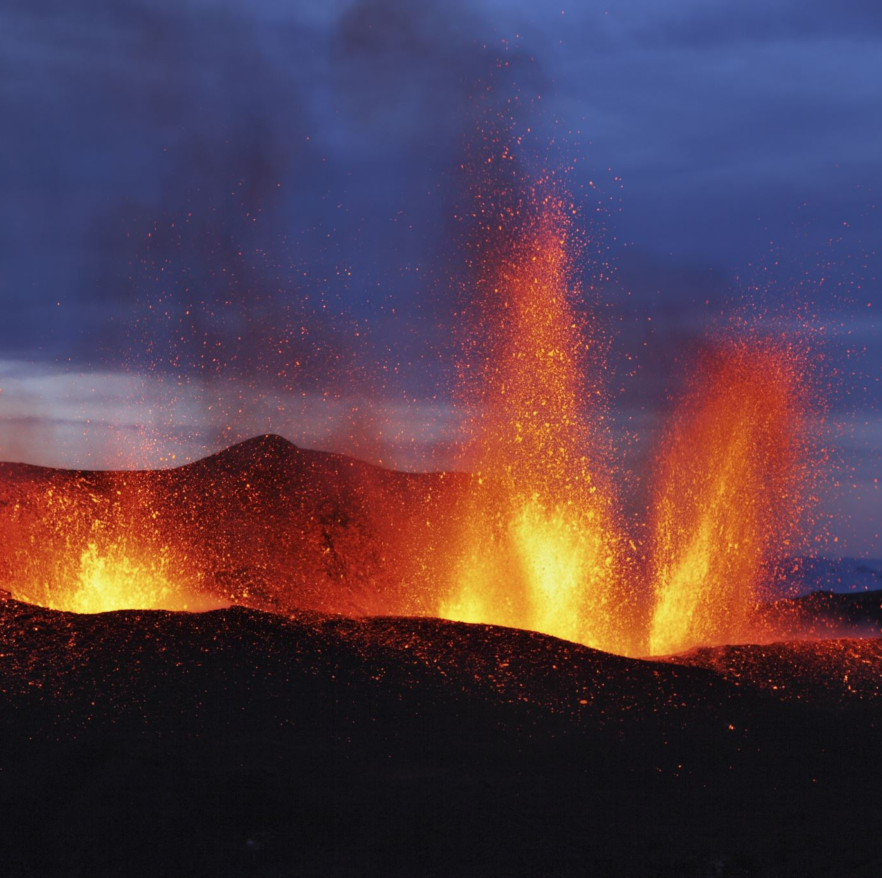

California Blaze Predictor: Forecasting Wildfire Intensity Using Environmental Factors
Presentation by: Group 1
Iyabode Ogunbode​
Yusuf Saadu​
Sufia Nooreen​
Jordan Bernot​

Slide 2
Introduction - Problem Statement
Project Aim :To study the effect of environmental factors throughout California on wildfire intensity.
Project Purpose : To develop a predictive model that utilizes these environmental conditions to produce a reliable forecast for the intensity of wildfires within the state.
Project Value : The predictive model as proposed can prove crucial for providing timely wildfire warnings, efficient resource planning, and enhancing environmental conservation in response to climate change.
Project Benefactors/End Users : CAL FIRE, California's local government & firefighters
Project Endgame/Benefit : The consequence of these added benefits is saving lives and protecting valuable property. In addition, our research could serve as a blueprint for enhancing wildfire preparedness and reducing its impact in high-risk regions across the globe.

Slide 3

Research Questions
What is the relationship between environmental factors and wildfire intensity and frequency? Which environmental factors affect wildfire occurrences more?
How can a data-driven approach to risk assessment assist in the mitigation of wildfire emergencies in California?
How do we measure or certify the accuracy of the model? What is the best evaluation metric for success?

Slide 4

Literature Review
Previous studies used tree-based models like XG Boost to improve wildfire prediction accuracy (Chen & Guestrin, 2016)
Previous studies developed neural network models for predicting the scale of wildfires using meteorological factors (Liang et al., 2019)
Northern California has been the focus of some research (Malik et al., 2021)
Supports climate change theories, highlighting the roles of increased temperatures and varied precipitation to wildfire incidents (Wibberly, 2021)

Slide 5
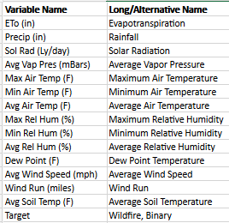
Dataset
Data from Kaggle
Collected over a 33-months period
128,126 records
14 environmental factors
Ex. Dew point, wind speed, soil temperature
Data covers 14 regions throughout California
Ex. Sacramento Valley, San Joaquin Valley, etc.

Slide 6

Methodology
What models were we considering
Supervised learning algorithms
Naïve Bayes, K-nearest Neighbor, etc.
What models did we eventually select
SVM, Random Forest, XG Boost
Why did we select these models
Better performance
Can handle complex and large datasets
Not sensitive to outliers or slightly skewed data
Appropriate for categorical variables

Slide 7
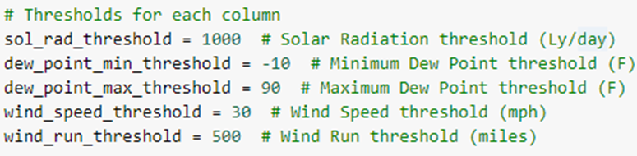
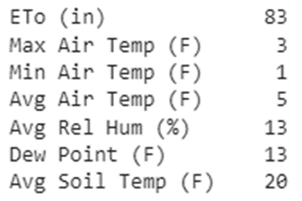
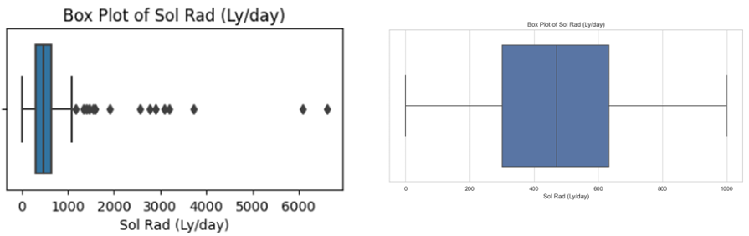
Data Preprocessing
Dropping unnecessary columns with Min and Max values of Air Temperature and Relative Humidity.
Handling missing values using mean imputation.
Removing outliers by setting thresholds for each column based on domain knowledge and statistical analysis.
Thresholds set for each column:
For example, change in Sol Rad (Ly/day) Box Plot after handling outliers:
Notes:
In our first step, we dropped unnecessary columns related to Min and Max values of Air Temperature and relative humidity.
Next, we encountered some missing values in our dataset and instead of dropping the records, we employed mean imputation.
Further, we had to deal with some unrealistic extreme values in our dataset. We set thresholds based on domain knowledge for specific columns to identify and remove such outliers.
Handling extreme values has proven to show good results in our subsequent analysis.
For example, on the slide we have two box plots related to Solar Radiation. The first box plot demonstrates the presence of outliers. The second box plot displays a cleaner distribution after removing these outliers.

Slide 8
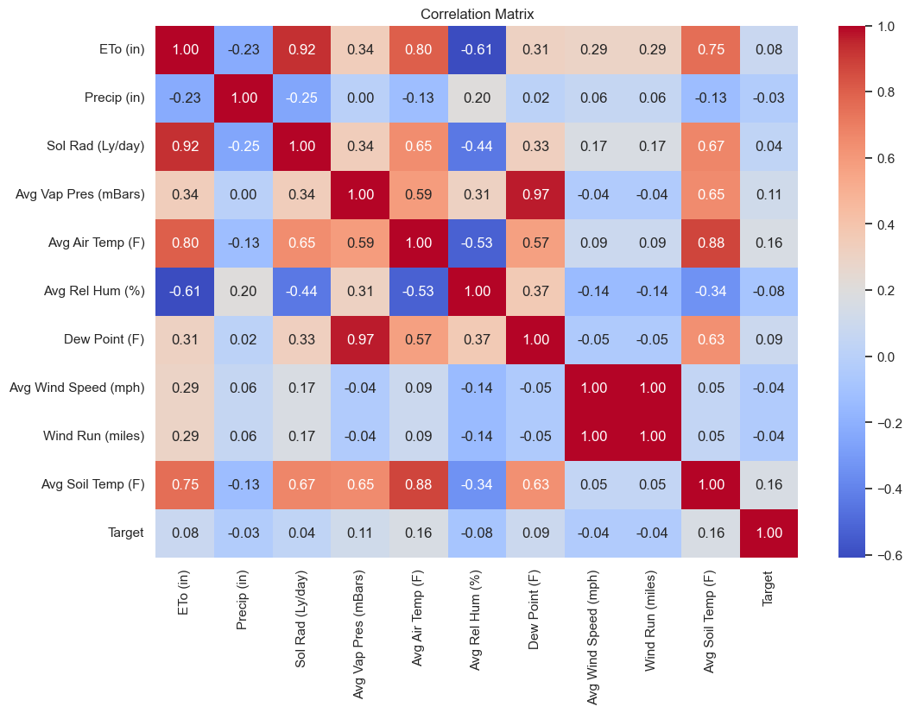
Correlation Analysis
Key Observations:
Eto (in) - Sol Rad (Ly/day): Strong positive correlation
Higher solar radiation leads to increase in Eto levels.
Avg Soil - Air Temperatures: Strong positive correlation
Air temperature impacts soil temperature.
Wind Run and Avg Wind Speed show perfect correlation. We dropped the column 'Wind Run' to deal with this issue and noticed improved results in our analysis.
Dew Point - Avg Vapor pressure: Strong positive correlation
Both are related to moisture content in the air.
Notes:
Next, we conducted correlation analysis to understand relationships between different environmental variables.
We have attached the heatmap on the slide for better understanding.
We observed strong correlation between some pairs of variables like Eto and Solar Radiation showing positive correlation, and so on.
Environmental variables have a certain level of correlation among each other, so this outcome was expected.
Wind Run and Avg Wind Speed however showed a perfect correlation. Given this, we have dropped the wind run column which led to improved results in our subsequent analysis.

Slide 9
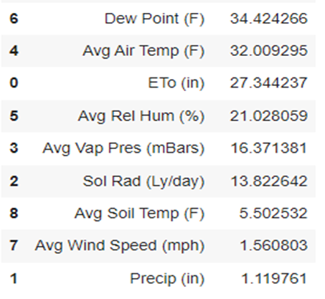
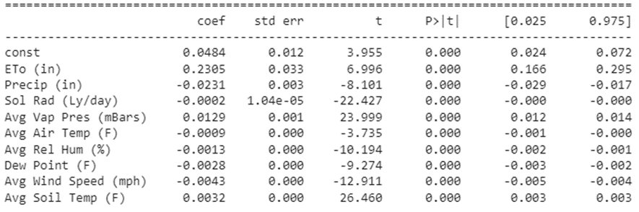
Assumption Tests
Multicollinearity Test:
VIF (Variance Inflation Factor) scores are used to assess intercorrelation among predictor variables. Generally, VIF scores of less than 10 are considered acceptable. The majority of our predictor variables exhibited low scores.
Significance Test:
Running logistic regression revealed that all environmental variables had p-values of 0.00, indicating a significant relationship between them and the target (wildfire occurrence) variable.
Notes:
We ran certain assumption tests on our dataset.
First, we performed a multicollinearity test to assess intercorrelation among predictor variables using the VIF scores. (Variance Inflation Factor).
Generally VIF scores less than 10 are considered acceptable and the majority of our predictor variables exhibited low scores.
We further tested for significance of each of these variables in relation to the target variable by employing logistic regression.
As we can see, all of the p-values were close to 0 implying that all the environmental variables are significant in predicting wildfire occurrence.

Slide 10
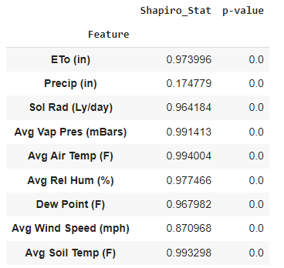
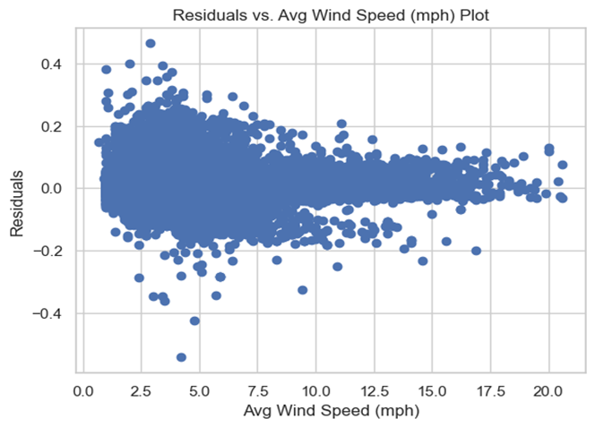
Assumption Tests
Normality Test (Shapiro-Wilk Test):
All environmental features have p-value < 0.05 suggesting non-normal distribution.
Normality tests are sensitive to large datasets.
Environmental variables often exhibit non-normality due to extreme condition.
Homoscedasticity Test (Breusch-Pagan):
All environmental features have p-value equal to 0.0, revealing heteroscedasticity, which means variance in the residuals/errors is not constant.
This is not unexpected in environmental data due to its complexity and natural variability.
Notes:
We further conducted normality tests using the Shapiro-Wilk test which showed that all environmental features had p-values less than 0.05 indicating that data wasn’t normally distributed.
It’s important to note that normality tests can be sensitive in large datasets such as ours.
Next, we conducted a homoscedasticity test, the Breusch-Pagan test, which revealed that all environmental features had p-values equal to 0, indicating heteroscedasticity in the residuals.
These two results were not unexpected due to the inherent complexity and natural variability present in environmental conditions in our dataset.
We have explored models that are robust in tackling datasets with such characteristics.

Slide 11
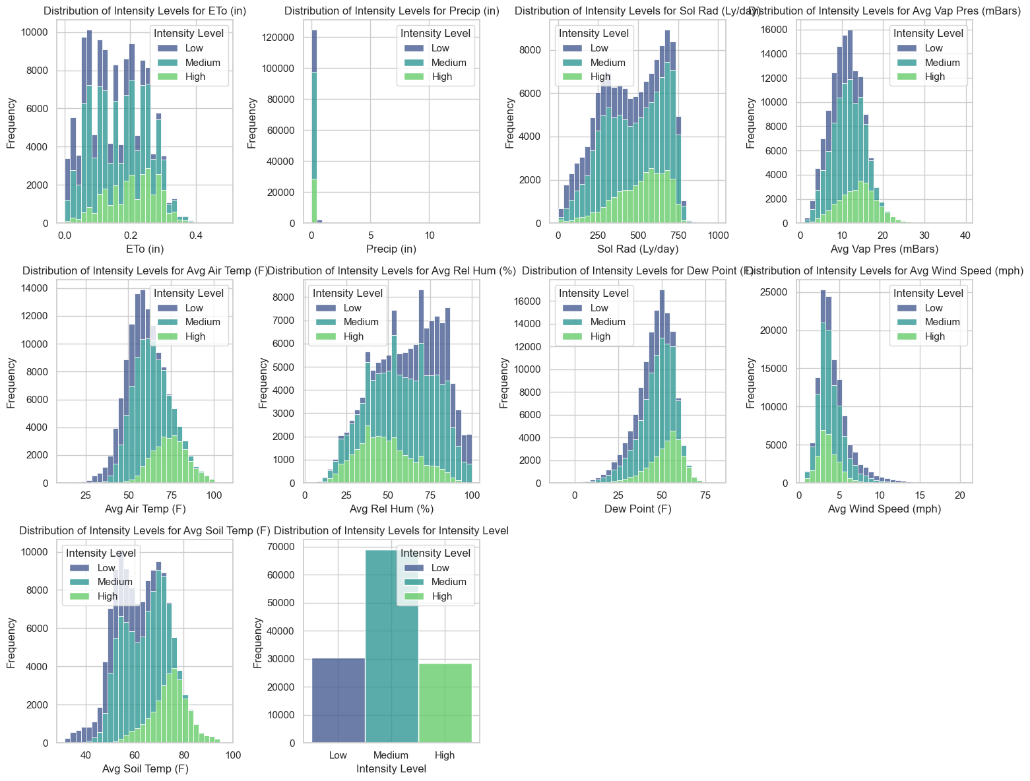
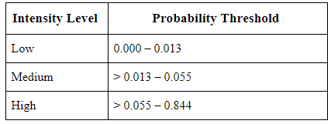
Feature Engineering
We’re manipulating environmental variables to create a new dependent variable called the ‘Intensity Level’.
We utilized probabilities derived from logistic regression to establish this new target variable.
The Intensity level was categorized into 'Low', 'Medium', and 'High' levels based on thresholds that were derived from quartiles from probability distribution.
Notes:
In the next steps of our analysis, we performed feature engineering to create a new dependent variable called ‘Intensity Level’.
Our goal was to move beyond simply predicting wildfire occurrence and forecasting the intensity levels of wildfires.
To create the intensity levels, we utilized probabilities derived from logistic regression using which we categorized intensity into three distinct classes: Low, Medium, High.
These thresholds were determined based on quartiles from the distribution of probability.
Low intensity level - 0 to the 25th percentile. Medium - 25th and 75th percentile. High - beyond 75th percentile.
These are the distributions of intensity levels for each environmental variable where purple is low, blue is medium, and green is high.

Slide 12
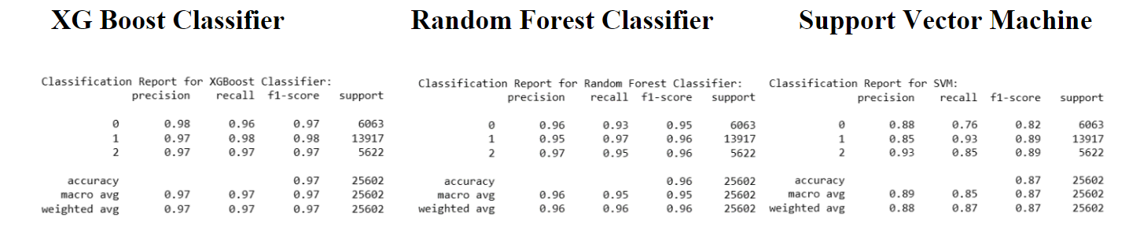
Model Comparison
The XG Boost model exhibited the highest rate of accuracy of 97%.
We selected the XG Boost Classifier model because it demonstrated the best performance metrics for precision, recall, and F-1 score out of the three models.
We believe this model to be the best in making predictions for the wildfire intensity levels in California based on environmental data.
This was expected because XG Boost Classifier can handle complex and heterogeneous data.
Notes:
We have run three classification models in predicting wildfire intensity levels, XGBoost, Random forest classifier, and Support Vector Machine.
Before training the models, we preprocessed the data by encoding categorical intensity level variables into numerical labels 0, 1, 2 for low, medium, high respectively.
XGBoost exhibited the highest accuracy rate of 97%. But this wasn’t the only basis on which we selected XGBoost. We assessed multiple performance metrics such as precision, recall, and F1 score and as you can see on the screen, XGBoost performance surpassed all others.
This classification model has the ability to handle complex, heterogeneous data which aligns it well with our environmental dataset.
The selected XGBoost classifier is the best model in making accurate predictions for wildfire intensity levels in california. This will aid in wildfire management, efficient resource allocation, and risk mitigation strategies.

Slide 13
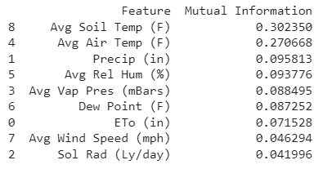
Discussion & Results
RQ 1: What is the relationship between environmental factors and wildfire intensity and frequency? Which environmental factors have the largest relationship with wildfire occurrences?
Precipitation, Average Soil Temperature, Air Temperature & Relative Humidity.
Notes:
For our discussion, we will be responding to our research questions and limitations of our study. In response to RQ1, we were able to find the relationship between the environmental variables and wildfire intensity using ANOVA F and mutual information scores. We decided to use the mutual information score to answer the question due to its ability to handle complex relationships. We found that precip, soil and air temp, and hum greatly influenced wildfire occurrences than the others. Our findings can be supported by Wibberly's study which demonstrated that increased temps and varied precips greatly influenced wildfire incidents.

Slide 14
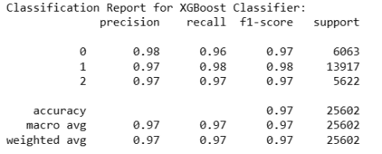
Discussion & Results
RQ 2: How do we measure or certify the accuracy of the model? What is the best evaluation metric for success?
Recall, F1 & Precision scores
RQ 3: How can a data-driven approach to risk assessment assist in the mitigation of wildfire emergencies in California?
Forecasting wildfire risks & optimizing resource allocation
Notes:
In response to question 2, we want our model to accurately identify wildfire intensities, with more emphasis on high-intensity levels for better resource allocation during wildfire events. That is why we could certify the accuracy of our model and say the best evaluation metrics for success were Recall, Precision, and the F1 scores. Our answer can be supported by Zhou et al.'s 2021 study, where they recommended using multiple metrics for a comprehensive evaluation of scenarios with unbalanced data for their fire point prediction.
RQ2: This study uses accuracy, precision, recall, F1-score, and AUC value to make a comprehensive evaluation of the model prediction accuracy and address the classification problem of unbalanced data of fire point prediction (Zhou et al, 2021). Fire Prediction Based on CatBoost Algorithm (hindawi.com)
RQ3: In response to Research Question 3, our model could offer insights for mitigating wildfire risks in California. Our model could help CALFIRE in making informed decisions for resource allocation. This approach not only helps in efficiently managing firefighting efforts but also plays a crucial role in preserving lives, property, and the environment, reducing the risks and impacts of wildfires.

Slide 15



Discussion & Results
Limitations of Our Research Study:
Limited to only California regions
Exclusion of other factors that may influence wildfire intensity levels
Time constraints
This Photo by Unknown author is licensed under CC BY-SA.
Notes:
Our study has a few limitations. It focused only on California, which could limit its usability to regions with different topography. Our dataset did not include other factors that may influence wildfire intensity levels. Our dataset only focused on a specific period, spanning only from 2016 to 2018. This time constraint limits our analysis to these years and may not fully capture longer-term trends or variations in wildfire patterns and intensities

Slide 16

Conclusion
Practical Applications:
Prediction of wildfire's intensity levels based on environmental factors
Recommendations:
Using high and medium intensity levels for appropriate wildfire mitigations.
Implications:
Assisting CAL FIRE in making more data-informed decisions for resource allocation.
Future Directions:
Model Generalization and Adaptability
Multifactorial Wildfire Risk Research Study
This Photo by Unknown author is licensed under CC BY-NC-ND.
Notes:
Summarize the key points of your presentation.
Highlight the significance of your research
Practical Applications:
Predicting wildfire intensity levels based on environmental conditions.
Using feature selection techniques for wildfire risk's model accuracy (ANOVA F and mutual information score)
Recommendations:
Using high and mid intensity levels to prevent damages/losses from wildfire
Using recall and precision as the main metrics for evaluating a model's performance
Implications:
Assists CAL FIRE in making more data-informed decisions when it comes to allocating resources
Effectively responding to wildfires by saving lives and mitigating risks
Removing uncertainty when it comes to managing wildfire incidents
Future Directions:
Model Generalizability and Adaptability: Testing the model's performance in different regions outside of California to assess generalizability and adaptability to different environmental conditions.
Multifactorial Wildfire Risk Assessment: Future studies could analyze socio-economic and ecological data with environmental conditions for a more comprehensive wildfire risk analysis.

Slide 17

Questions from the Audience?

